Slide 1
A Guide to Studying Fus'ha Arabic in Egypt: Preparing for Your Trip, Maximizing Your Learning, and Maintaining Your Progress
hAMDI MOHAMUD

Slide 2
Contents
Introduction
My Story
Before Your Travels
During Your Stay
After Your Travels
Final Advice

Slide 3
introduction
Welcome to this guide to learning Fus'ha Arabic in Egypt. I am thrilled to share my personal experiences and insights with you as you prepare to embark on your own journey of learning this beautiful language. My time studying Arabic in Egypt was filled with amazing learning opportunities, and I am eager to pass on my lessons learned and knowledge gained to help you make informed decisions about your own journey. So, get ready to discover the wonders of learning Fus'ha Arabic in Egypt and make the most of your experience. Let's get started!

Slide 4
My story
Traveled to Egypt in 2014, to study Fus’ha Arabic
Stayed for 10 months
Studied at two renowned language centers:
  Fajr Center for Arabic Language
  Al Ibaanah Arabic Center
Made significant progress in my ability to:
  Read
  Write
  Understand the Arabic language
Continued with Arabic studies after leaving Egypt
Read more on my blog: https://www.hamdimohamud.com/blog/studying-fusha-arabic-in-egypt-for-10-months

Slide 5
Before Your Travels
Before traveling to Egypt to study Fus'ha Arabic, it's crucial to take the time to prepare and make the most of your experience. In this guide, I will focus on four key areas of preparation:
  Visa requirements
  Financial planning
  Finding the right Arabic institute in Egypt
  Accommodation

Slide 6
Visa Requirements
When traveling to Egypt to study Arabic, it's important to understand the visa requirements. Here are two options to consider:
  Apply with an Arabic institute: If you already know which Arabic institute you'll be attending, it's best to apply for your study visa through the institute. This will make the process smoother and quicker. If you're traveling from a country that isn't eligible for visa on arrival, it's recommended to apply for your study visa before your travels.
  Visa on arrival: If you're not sure which institute to attend and your country is eligible for visa on arrival, you can travel to Egypt for up to 30 days and then find an institute to apply for your study visa. This option gives you the flexibility to choose an institute that aligns best with your goals and budget.
Regardless of which option you choose, it's essential to check the latest visa requirements and regulations before traveling to Egypt. Check this website for more information: https://www.egyptianevisa.com/visa-requirements

Slide 7
My personal experience with visa requirement
My experience with visa requirement:
  I traveled to Egypt from the United States in 2014 and was able to obtain a visa on arrival for a period of three months. However, since I wanted to study Arabic for a longer period, I applied for a study visa after three months. I used my Arabic institute's letter to apply for the study visa and was granted a visa that was valid for one year. Although I was able to successfully obtain my study visa, the process of applying for it was challenging and I do not recommend attempting it without assistance.

Slide 8
Financial Planning
Determine the cost of tuition and any other fees associated with your Arabic program.
Estimate the cost-of-living expenses such as accommodation, food, transportation, and entertainment.
Create a budget that includes all your estimated expenses and make sure to factor in any unexpected costs.
Consider the cost of travel, including flights and visas.
Plan for any additional expenses such as medical insurance, travel insurance, and personal items.
Look for ways to save money, such as sharing accommodation or cooking meals instead of eating out.
Consider the currency exchange rate and have a plan for managing your finances during your time in Egypt.
Financial planning is a crucial part of preparing for a trip to Egypt to study Arabic. By taking the time to create a budget and plan your finances, you can ensure that you have the resources you need to make the most of your experience.

Slide 9
My Financial Planning
When I traveled to Egypt in 2014 to study Arabic, I had a budget of $3000 which lasted for the entire eight months of my stay.
  I lived with my aunt for the first four months and only had to pay for my tuition, transportation, and miscellaneous expenses.
  For the remaining four months, I shared a room with a friend and paid $150 for rent and internet, as well as expenses for food and other miscellaneous items.
  To keep my spending to a minimum during my eight-month stay in Egypt, I made a conscious effort to limit my expenses. I walked to my Arabic institute since it was close to my apartment, ate most of my meals at home, and only went out for special occasions or to try new experiences. By making these small changes, I was able to manage my finances effectively during my trip to Egypt.

Slide 10
Arabic institute in Egypt
When it comes to Arabic institutes in Egypt, it's important to choose one that best fits your needs and goals. Here are some factors to consider:
Location: Choose an institute located in a safe and convenient area, close to your accommodation and other necessities.
Program offerings: Consider the type of program you want to enroll in, whether it's an intensive course, a part-time program, or a long-term course.
Class sizes: Look for institutes that offer small class sizes, which allow for more personalized attention from teachers.
Curriculum: Consider the curriculum of each institute and choose one that aligns with your learning style and goals.
Reputation: Research the reputation of each institute, read reviews from current students and alumni, and speak with them to get a better understanding of each institute.
Cost: Compare the cost of each institute and factor in all associated fees, such as housing, books, and materials.
Availability: Check if the institute you're interested in has availability for the dates you're planning to travel.
By considering these factors, you can choose an Arabic institute in Egypt that best aligns with your goals and budget.

Slide 11
List of Arabic institute in Egypt
Al-Ibaanah Arabic Center
Fajr Center for Arabic Language
Qasid Institute
Al-Diwan Center
Qortoba institute for Arabic studies
Nile Learning Center
Kalimāt Language & Cultural Centre
Lisan Al-Arab Language Center
Noon Center
Hedayet Institute
Al-dirassa Center – Online Institute
These institutes have received positive feedback from students who have studied there, and I personally have had a positive experience with some of them. It's important to note that everyone's experience is different, and what works for one person may not work for another.

Slide 12
My personal experience with
Arabic institute in Egypt,
I studied at
  Al-Ibaanah Arabic Center
    Focused more on grammar
    Small class size
    Amazing teachers
  Fajr Center for Arabic Language
    Focused more on vocabulary
    Small class size
    Amazing teachers

Slide 13
Accommodation
When it comes to finding accommodation, it's important to prioritize both safety and proximity to your language institute. You'll want to choose a place to stay that is both safe and secure, and that is conveniently located close to your institute. This way, you'll be able to focus on your studies and not have to worry about long commutes or safety concerns. When researching potential accommodations, be sure to consider the location, safety, and overall living conditions. And don't hesitate to ask the Arabic institute for recommendations on nearby housing options.
My advice is to look for accommodations in Nasr City. This area is home to many language centers, making it a convenient location for students. Additionally, Nasr City is also the location of Al-Azhar University, one of the world's leading Islamic universities. By staying in Nasr City, you'll be in the heart of the language and cultural learning opportunities that Egypt has to offer.
I lived in Al Hayy Ath-Thāmin (8th district) in Nasr City. This was close to both Al-Ibaanah Arabic Center & Fajr Center for Arabic Language.

Slide 14
During Your Stay
Maximizing your learning is the most important thing to consider during your stay. Here are some tips for doing just that:
Attend class regularly: Consistent attendance is crucial for making progress in your Arabic studies. Make sure to attend all your classes, do your homework, be fully present and engaged while there.
Practice outside of class: In addition to attending class, it's important to practice speaking and using Fus’ha Arabic outside of class as well. This can be done through speaking with locals (but make sure its Fus’ha and not Amiyah)
Immerse yourself in the language: listen & watch programs in Fus’ha Arabic such as the news. Also Friday Khutbah can be a good resources for listening and improving your understanding
Taking thorough notes during classes

Slide 15
Ways I Maximized my learning while in Egypt
Consistent class attendance: I attended classes 5 days a week, making sure to never miss a class.
Daily homework: I made sure to do my homework every day, which helped reinforce what I learned in class and improve my Arabic skills.
Reviewing notes: I reviewed my notes before and after each class, making sure to understand and retain the information presented.
Watching Arabic programs: I made a habit of watching programs in Fus'ha Arabic, which was mostly cartoons. This helped me improve my listening and comprehension skills in a fun and engaging way.
Attending Friday khutbah: I attended Friday khutbah regularly to practice my listening and understanding of Fus'ha Arabic. This was my favorite way of practicing the language.
Taking good notes: I took thorough notes during my classes and made sure to maintain those notes after each class.
Having a study buddy: I found it helpful to have a study buddy who was in the same level as me. This allowed us to practice speaking and help each other with our language skills.

Slide 16
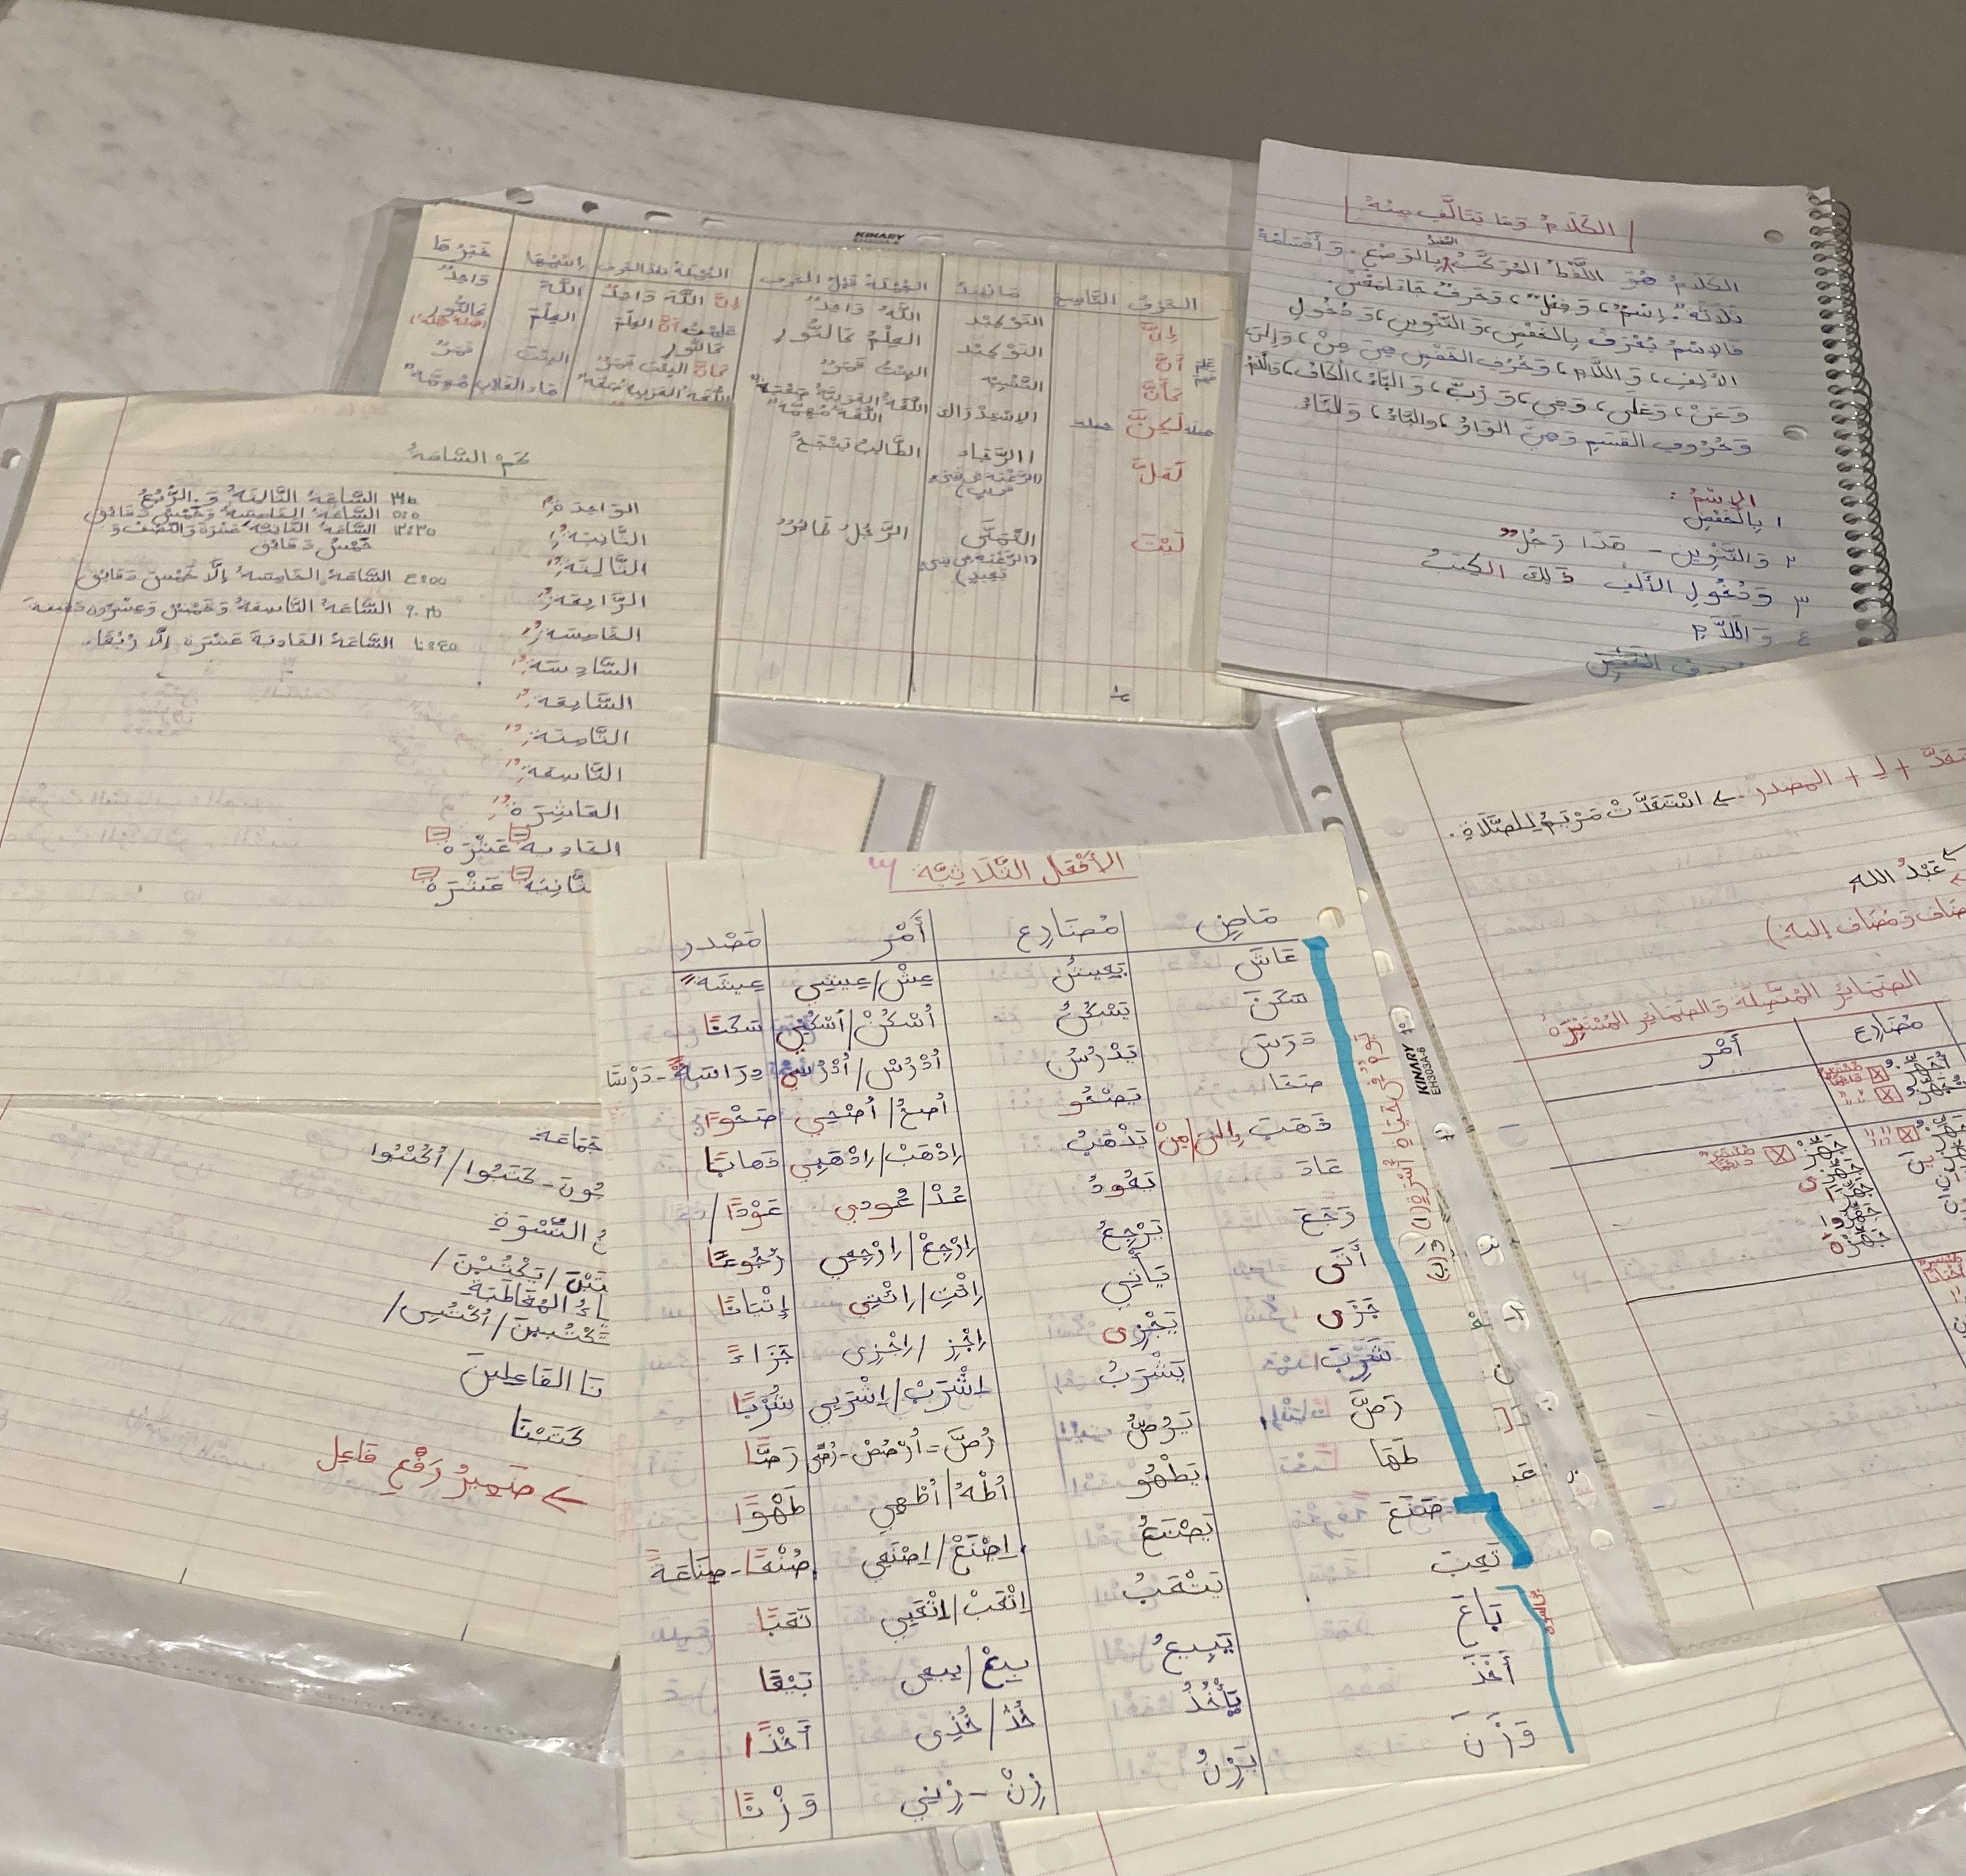
Some of my class notes

Slide 17
After Your Travels
The main thing to consider after your travels is maintaining your Arabic skills. Here are some effective ways to do that:
  Continue with an online institute: Consider enrolling in an online program with the same institute you attended in Egypt to continue your Arabic studies. Arrange this before you leave the country to ensure a seamless transition. Many of the Arabic institutes listed offer both in-person and online options.
  Keep your materials: Bring all your notes and books with you to use as resources for your continued learning.
  Teach what you know: Share your knowledge with others by teaching what you learned during your time in Egypt. This will help you retain your Arabic knowledge and benefit your community.

Slide 18
maintaining my progress after I returned
Maintaining my progress in Arabic after returning from Egypt was a challenge, but I initially took steps to continue my learning. I enrolled in Al-dirassa center, an online Arabic institute, and continued to listen to Arabic programs and read Arabic books.
However, as time went by, I fell out of my studies and eventually stopped completely. This was a regretful choice as it resulted in me losing a significant amount of my progress. The lesson I learned from this experience highlights the significance of being consistent and setting attainable goals in language learning.
This is one of the reasons I am writing this guide, to reignite my motivation and help others avoid similar pitfalls.

Slide 19
Final advice
If you have always dreamed of traveling to Egypt to study Fus'ha Arabic, then do it! You will not regret it. Proper preparation and putting your trust in Allah is key.
  I left university to pursue my dream of studying Fus'ha Arabic in Egypt!
For those who cannot travel, there is still the option to study online. Most of the Arabic institutes listed offer online programs, so there are no excuses. Use this as motivation and enroll in an online institute from the list and start your journey.
For those like myself who have put in effort to learn Fus'ha Arabic through travel or local studies but have fallen off, it's never too late to renew your intentions and continue your studies. Studying the Deen of Allah is a lifelong commitment and should never be abandoned until death.

Slide 20

Thank you for reading this guide to learning Fus’ha Arabic in Egypt. I hope that you have found this information valuable and that it will help you make the most of your travels and your Arabic studies. If you have any further questions or need more information, please don't hesitate to reach out. Best of luck in your Arabic studies and travels!
Website: https://www.hamdimohamud.com/
Twitter: https://twitter.com/hamdimahmuud
Instagram: https://instagram.com/hamdimohamud_/

